Slide 1
Coronavirus/Covid 19
Living with Covid

Slide 2
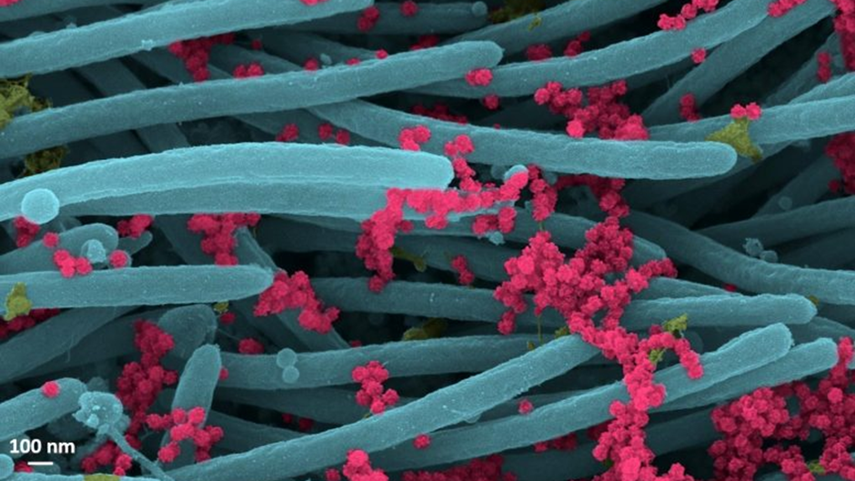

Slide 3
The photo:
These are what are known as SARS-Cov-2 virions under electron microscopy on the cilia of cells in the human respiratory tract. The yellow is mucus, the red SARS Cov 2 , these are then sneezed , coughed out etc and spread – further in the individual or as droplets into the air for transfer etc.
Virions are the complete, infectious form of the virus released onto respiratory surfaces by infected host cells.
This imaging research helps illustrate the incredibly high number of virions produced and released per cell inside the human respiratory system. The large viral burden is a source for spread of infection to multiple organs of an infected individual and likely mediates the high frequency of COVID-19 transmission to others. These images make a strong case for the use of masks by infected and uninfected individuals to limit SARS-CoV-2 transmission.
Reference: “SARS-CoV-2 Infection of Airway Cells” by Camille Ehre, Ph.D., 3 September 2020, New England Journal of Medicine.
DOI: 10.1056/NEJMicm2023328
NB 100nm is the thickness of a sheet of plain A4 paper..
Chris Freestone. Dialogue . 9.2020

Slide 4
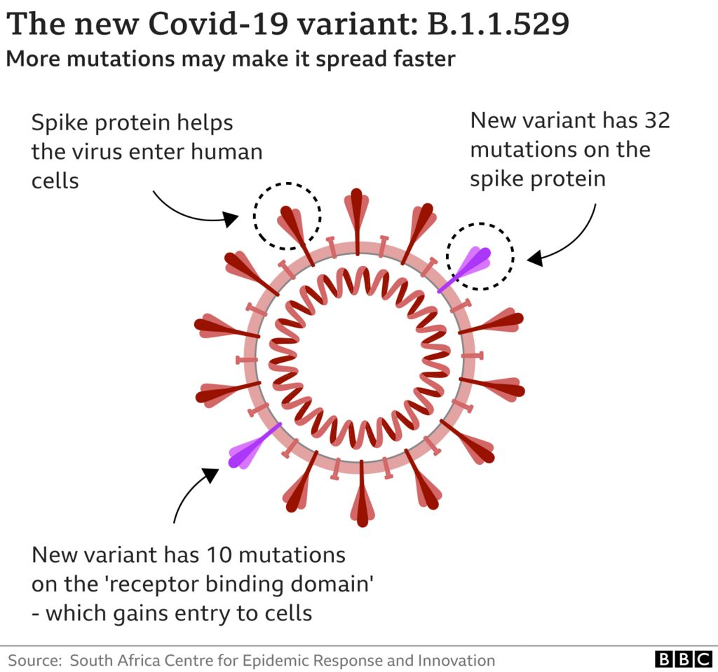

Slide 5
Current data
R rate- 0.7-1.0 – ENGLAND
R rate varies across England – nowhere above 1.0 as the top rate
X2 vaccinations – 85.1%
Booster/ third dose- 66.3%
Cases- 32-35 K per day
Deaths- 120 per day
Admissions – 1100-1200 per day

Slide 6
For us to think about…… with changes in restrictions have you?
Made sure you are aware of the changes announced last week
Assessed whether as a home you are retaining key elements of managing risk e.g. Visitors to the home, potential use of PPE.
We still have Omicron and Delta variants in circulation….. though numbers are now going down.
Incorporated your thinking into a clear plan going forward.

Slide 7
Ongoing…….
The outcome of the pandemic for children and young people is said to be likely to “impact a generation.”
It is also being referred to as the ongoing “covid recovery decade”
This gives us some idea of the timescale associated with addressing key issues related to :
Health provision ....Community
Economic recovery

Slide 8
Ongoing….
NHS recovery
Access to services e,g. Mental health services, CAMHS,other therapies
Infrastructure
Onward planning re.education recovery- infrastructure and curriculum / learning recovery
Anticipated Increase in looked after children. c.102 k by 2025. Up from approximately 82 K.
Recovery if effective multi agency systems

Slide 9
Other thoughts....
Long term booster roll out.... Spring 2022 and likely autumn / winter as for ‘flu.Vulnerable groups.
Ongoing vaccination programme...not yet decided by JCVI
How will you manage risks related to staff not legally having to self isolate now.
Ongoing access to LFT after April 1^{st .}
LFT costs
Will be available to certain vulnerable groups free of charge...thus will be limited
New variants …….being monitored. Lifting the restrictions is clearly linked to vaccination. However,we know that immunity wanes over time , so monitoring of variants will have to carry on to check they are not more transmissible, do not cause serious illness, are vaccine avoidance.
Notes:
Impact on staffing throughout….

Slide 10
Living with Covid- government plan
https://www.gov.uk/government/publications/covid-19-response-living-with-covid-19
Key document .
Likely to be further guidance from health , education and social care

Slide 11
What next?
Pull together a short,medium to long term plan
Be aware .... The temptation for everyone after a difficult 2 years will be to relax. This could lead to problems. It is expected that there will be a spike in cases over the next month
Other issues to also consider..... Publication of the Independent Care Review report and the final report of the Competition and Marketing Authority

