Slide 1
NWG Network
Child Exploitation
Residential Leads Meeting
Maria Cassidy
Families and Communities Lead NWG Network
maria@nwgnetwork.org
Notes:
For Presentation

Slide 2
NWG Network
Who are we?
National networking charity of 14,500 members from across the sectors working together to tackle exploitation at a local and national level
Originally a CSE charity now a Child Exploitation Charity
Maria Cassidy
Families and Communities Lead NWG Network
maria@nwgnetwork.org

Slide 3
NWG Network
Our membership offer
Training, practitioner forums and webinars
_{Exploitation Response Unit}
_{Surgerys and reviews}
Developing guidance, reports and resources in collaboration with key partners
Sharing Resources and learning through our knowledge hub
Campaigns
Notes:
Our offer
Teaining forum and webinaras
Sharing resources through our knowledge hub
Exploitation RU
Surgerys and reviews
Dev guidance reports resoruces
campaigns
Sport England funded to raise awareness around grassroots sports and sport and leiure sector.
Fits in with contextual safeguarding safer spaces and places
Doorstep sports youth sector
Role of families and communities
Next slide

Slide 4
Child Exploitation Context
“ There is an increasing number of teenagers experiencing a conveyor belt of familial vulnerability, conflict, exclusion, exploitation, care and custody.”
“Half of Black children in the UK are now growing up in poverty”
“When compared to their peers, children in residential care are at least 13 times more likely to be criminalised.”
“60% of children who offend have communication difficulties. Of this group, around half have poor or very poor communication skills “
(Commission Young Lives - A new partnership with families)
Of the 80,850 children in care in England in the year ending March 2021
23%. were over the age of 16
39% were aged 10-15
“Out of Harms Way”

Slide 5
Child Exploitation Current Themes
Taking the Learning from CSE into Wider Exploitation
​Contextual and Transitional Safeguarding and Working With Parents as Safeguarding Partners
​Sharing the learning and what works
​Gender bias, Adultification and Language

Slide 6
Taking the Learning from CSE into Wider Exploitation
The Independent Inquiry into Child Sexual Abuse (IICSA) said there was “a flawed assumption” that child sexual exploitation was “on the wane”, with councils and police forces denying the scale of the problem, despite evidence to the contrary
Underestimating the extent of CSE
Less known about the prevalence now than in 2015
Reports of CSE decreased
Widened response to child exploitation could be diluting the issue
Children being seen as “at risk” when they are being exploited
Failing to keep pace
CSE downplayed

Slide 7
Gender bias, adultification and language
Perfect and imperfect victims– adolescence and social care system
Un/Conscious bias - race and gender bias
Viewing safeguarding through an intersectional lens https://listenupresearch.org/
Victim blaming and minimisiation – how are we seeing children /what are we not seeing
Dehumanising language

Slide 8
Extra Familial Harm
Contextual and Transitonal Safeguarding
CONTEXTUAL
Recognising abuse outside the family home
Addresses contexts assessment and intervention
Encourages wider partnership working
TRANSITIONAL “Perpetrators target vulnerability not age” – Newcastle slogan
“It encourages greater fluidity between children and adult safeguarding processes and requires an active effort to align systems to create a smoother more holistic offer for people being supported”
Transition into independence and adulthood
Capacity not chronological
Reunification with families

Slide 9
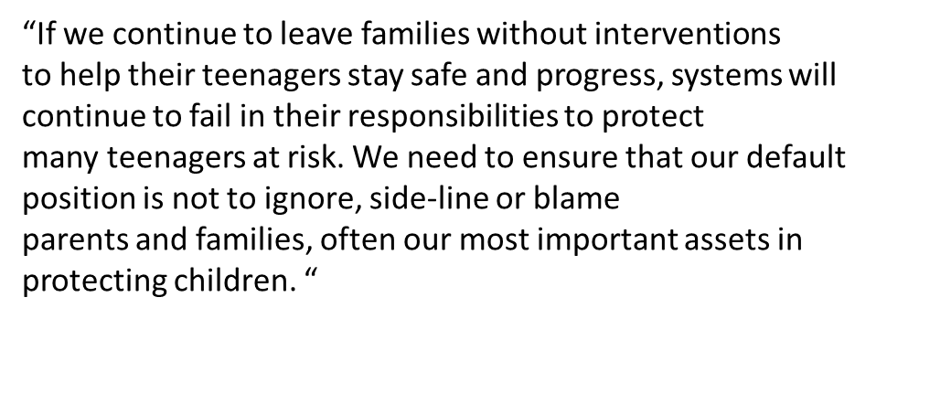
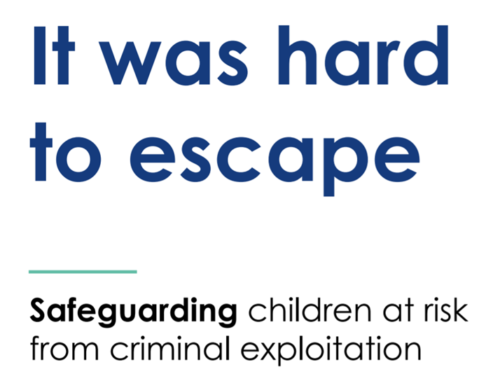
Extra Familial Harm - Families as Safeguarding Partners
Parental engagement is nearly always a protective factor
Parents and extended family members need effective support in helping them manage risk from outside the home. This is skilled work and requires building good relationships with parents.

Slide 10
Sharing the Learning
What is working well and making a difference for the young people in your care?
Who are the key partners that enable this?

Slide 11
​
NWG Exploitation Response Unit ​ Office: 01332 585371
Maria Cassidy Families and Communities maria@nwgnetwork.org
Kevin Murphy Safeguarding in Sport​ ​ kev@nwgnetwork.org
Bina Parmar Safeguarding in Sport bina@nwgnetwork.org ​
Steve Baguley Transitions steve@nwgnetwork.org Matt Thompson Police and Justice Lead matt@nwgnetwork.org

