Slide 1
21st March 2023 – Care Planning and ‘Behaviour’ – Kerry Turner will be discussing the impact of young peoples’ ‘behaviour’ on care planning and a fresh approach to ensuring their engagement is effectively captured throughout.

Slide 2
What is a care plan?
A plan of care is a presentation of information that easily describes the services and support being given to a young person to ensure the staff around the young person understands what they can carry out independently, and what they can to do support them to encourage these independent skills and how to challenge them to support them to make their next steps.

Slide 3
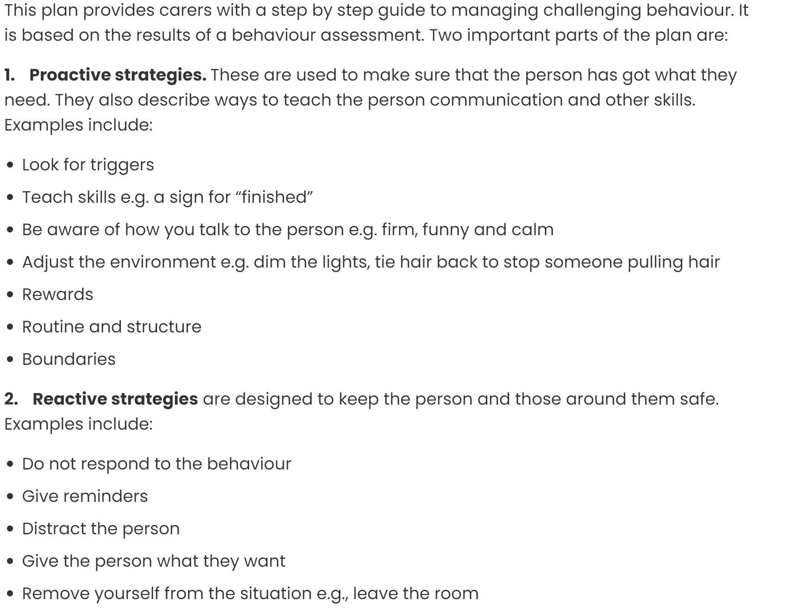
What is a behaviour support plan?

Slide 4
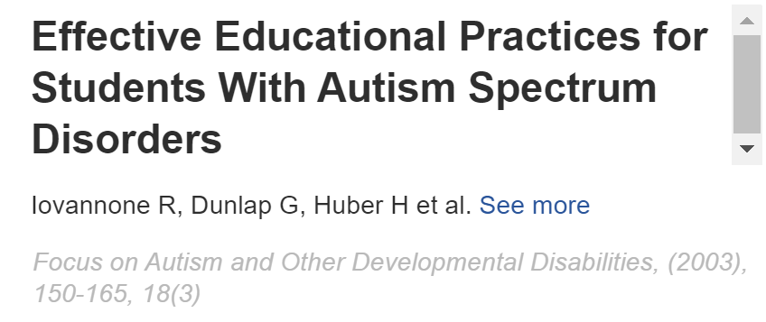
Engagement is the single best predictor of successful learning for children with learning disabilities (Iovannone et al., 2003). Without engagement, there is no deep learning (Hargreaves, 2006), effective teaching, meaningful outcome, real attainment or quality
Hargreaves, D. (2006). A new shape for schooling? London: Specialist Schools and Academies Trust.

Slide 5
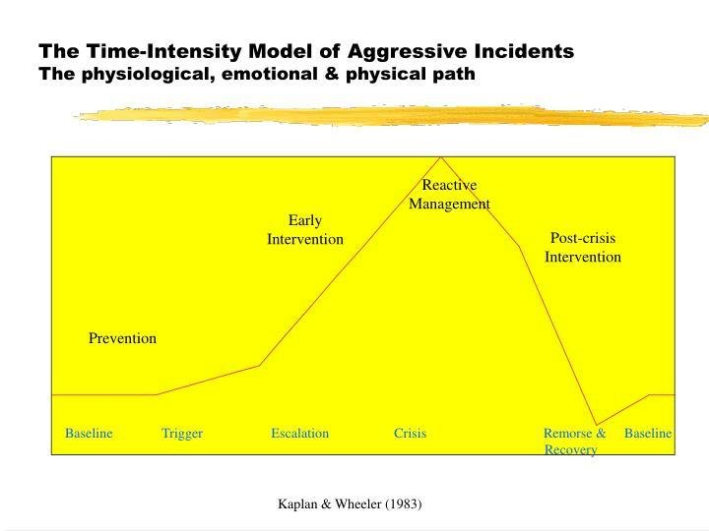
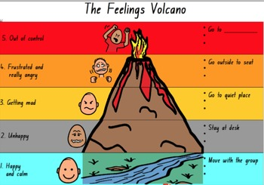
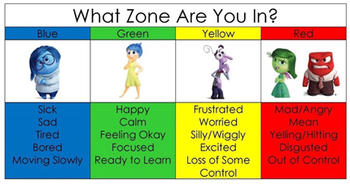
Historically- time intensity model /volcano/zones of regulation
All of these focus on the behaviour being presented and how to manage it or stop it.
Focusses on always getting the person to green or ok
Rarely accepting where they are
A behaviour support plan focusses heavily on behaviour we don’t want to see. Behaviour that challenges someone else.

Slide 6
What's wrong with focusing on behaviour that challenges?
We are always looking for it, therefore focussing on it
We write it down in so much detail and sometime examine so forensically
How many of us support individuals with behaviour that is tricky at time…… how many incident sheets have we written…

Slide 7
Behaviours that challenge
Carer wants/needs to avoid impact of behaviour
Carer responds
Person gains or avoids
Behaviour stops
Similar situations occur in the future
Events often always play out the same way….
This behaviour doesn’t really alter….
It often depends on us as adults and how we approach
the situation and support it.

Slide 8
Why do we look at Energy and not behaviour?
There is lot more to an individual than their behaviour.
When we think about energy, everyone has energy, and no energy level is “unacceptable”.
However, when we look at behaviour, why is biting 'unacceptable', when their energy may be feeling maxed out and need to let of steam through biting… biting me is not ok but biting something may be ok.
Shouting….. It might make me feel better…. Withdrawing…. It might make me feel better…. How do we support what need is behind the behaviour?
By looking at Energy levels allows us to be able to support the energy at the time, sometimes by ‘matching and catching’, sometimes by levelling up or even levelling down

Slide 9
So we flipped it…
Why…. We thought about how different it would be if we looked for what we wanted instead of what we didn’t want
Adults thinking changed
Language changed
Children changed
We started to support the childrens engagement instead.

Slide 10
How did we do it…
Engagement plans
Engagement levels
Level up/ energy
Reverse ABC
MUSTS reviews
Of course we have red plans and risk assessments but these are an add on not dressed up as plans to change anything or as a tool- simply as a way to keep children safe- everything else should be about the positive. A reactive plan is simply about safety- other wise it should not be reactive.

Slide 11
Outcomes
Our children at our home have much less restriction that previously
Better outcomes
Happier
Significantly reduced environmental restraints
Significantly reduced mechanical restraints
Very little intervention (2020= locked in a room at family home) 2021= 54 incidents 2022= 12 incidents
Our children at school are happy, they want to come, attendance is excellent, there is no physical restraint

Slide 12
Good engagement;
Improves a persons quality of life
Builds relationships
Improves learning
Increases happiness
Why is engagement important?
Quality of life
Challenging Behaviour

Slide 13
We shouldn't rely on getting an individual's behaviour back to a "calm state" or "back on green".
When an adult says "calm down" to an individual, this is what we want, not what they want or need. It is detrimental to minimize their feelings or express apathy in response to their sentiments
Sometimes we need to think about where they need to be
Focus on what keeps the person engaged

Slide 14
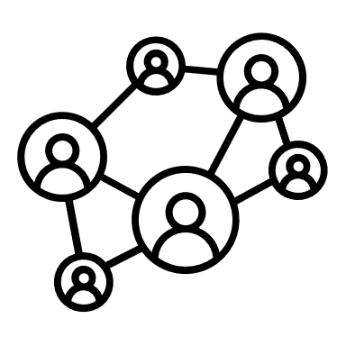
Transactional supports for success
Relationships and
interactions
Environments

Slide 15
A model for engagement
.
.
.
Motivation Understanding Safe and Ready Tools Skills

Slide 16
Combining the model with the supports-
skill development
TOOLS TOOLS
Environment |  | Relationships + interactions
 | Motivation
 | Understanding
 | Safe and Ready

Slide 17
Combining the model with planned development and change
Antecedent | Behaviour | Consequence
How do we ‘set up’ the environment to give the person the best chance of succeeding Motivation Understanding Safe and ready | What engagement do we want to see, what skills to we want to develop | How do we reinforce the skill or behaviour we want to see.

Slide 18
Any questions, comments or discussion points?

Slide 20
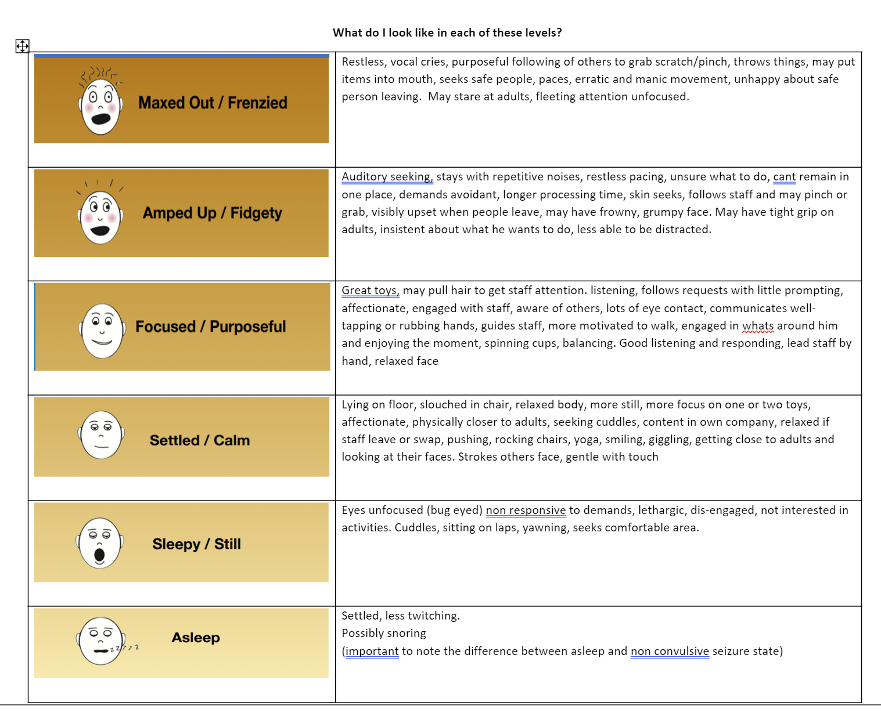
Level up plan

